Slide 1
Financial Performance Dashboard
USING POWER BI - Task 3

Slide 2
Objective & Dataset
To build an interactive dashboard for business stakeholders using financial data.
Dataset Used:
Financial Sample (Excel) – includes Sales, Profit, Segment, Country, Product, Date.
Tool Used: Power BI

Slide 3
Dashboard KPIs & Charts
Key KPIs Visualized:
- Total Sales
- Total Profit
Visuals Used:
- Line Chart: Monthly Sales Trend
- Column Chart: Profit by Country
- Pie Chart: Units Sold by Segment
- Map: Geographical Profit Overview
- Slicers: Country, Segment, Product
- KPI Cards: Total Sales, Profit

Slide 4
Design Highlights
Theme: Dark/Black background for modern look.
Color Contrast: Cyan, Lime Green, Yellow for high visibility.
Slicers: Custom-colored for interactivity.
Navigation: Clean layout for intuitive use.
Interactivity: Filters update visuals instantly.

Slide 5
Insights Observed
The US and France are the top-performing countries in terms of profit.
Technology Segment leads in overall sales and revenue.
Product "Copier" stands out as a top-seller.

Slide 6
Learnings
Creating dynamic, slicer-driven dashboards enhances usability.
Design elements like color contrast and layout impact engagement.
Power BI bookmarks and slicers enable professional navigation.
Real-time data insights are critical for business decisions.

Slide 7
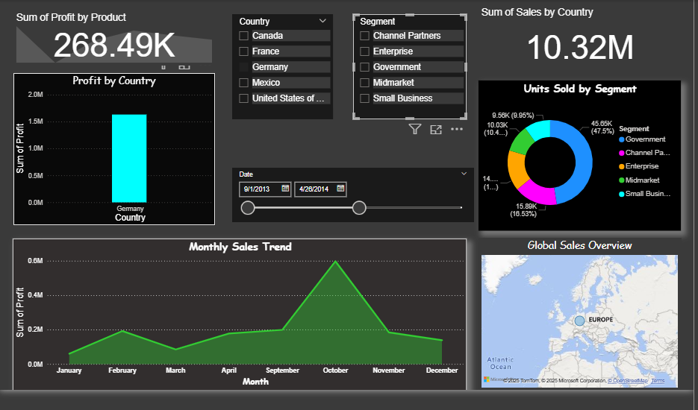
DASHBOARD

